Slide 1
Quantity of Scrap Glass: Please provide the specific figures regarding the quantity of scrap glass generated in Zone 17 over the last two months. If possible, break it down by week or any other relevant time frame.
Defects have been broken down by root cause that will result in glass being replaced/scrapped.
Root Causes: I would like to understand the primary reasons for the increase in scrap glass. Are there any identifiable process issues, equipment malfunctions, or changes in production procedures that might have contributed to this surge? Any details you can provide will be invaluable in identifying the root causes.
The primary reasons for model 1 scrapped glass are as follows: Robot details on either the suction cup, flip table, or unload table have caused the glass to crack. If the operator does not notice the damage during install it leaves the zone without being able to properly identify the root cause. Glass can be damaged during install due to the pin not being seated and the glass wet out process not being followed. If the tech either slaps the glass or applies too much pressure the glass will crack. There are multiple processes in the system that can damaged glass while installing parts near the bottom of the windshield.
Corrective Measures: Has any action been taken to address the scrap glass issue? If so, please share the steps that have been implemented to mitigate the problem and any improvements observed as a result.
All of the issues related to the robot mentioned above have been corrected. What we need to do now is establish TPM’s to ensure that we proactively stay in the current good condition. Processes in the system (hot spots) are being reviewed now to ensure that their processes have CDS details included. All camera systems in these hot spots are being reviewed to ensure that the process and the condition of the glass before and after can be seen via camera systems.
Team Feedback: I encourage you to consult with your team members and gather their insights on the matter. They might have firsthand knowledge of issues or potential areas for improvement. Kindly include any suggestions or feedback they might have in your response.
Dayshift and Nightshift leaders have been made aware of these issues during their tenure as leaders. We will provide this data on a regular basis to ensure that the scrap numbers are being driven down through the countermeasures implemented.
Future Preventive Measures: Based on your experience and expertise, are there any proactive measures or best practices that we could implement in Zone 17 to prevent or minimize scrap glass in the future? I would greatly appreciate any recommendations you could provide.
TPM’s will be created in zone to prevent occurrences that either z17 or our equipment can cause. We will work with the hot spot zone’s supervisors to ensure that regular job observations are performed or items are added to their Control Item List for review.

Slide 2
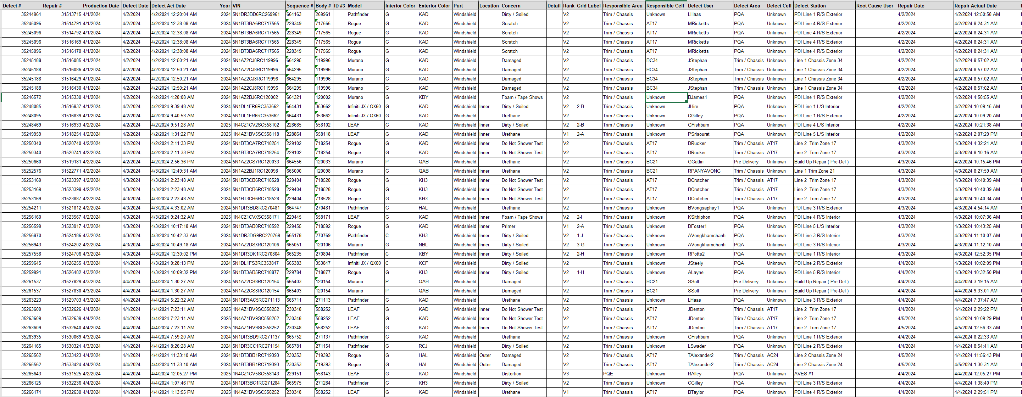
Data is pulled from our defect entry system to start the investigation process. The data can be pulled from the system based on defect type and part type. The snip above is half of the raw data attached to each windshield that is damaged. This data is trended by entering into excel worksheets that auto populate into charts shown in the next slides.

Slide 3
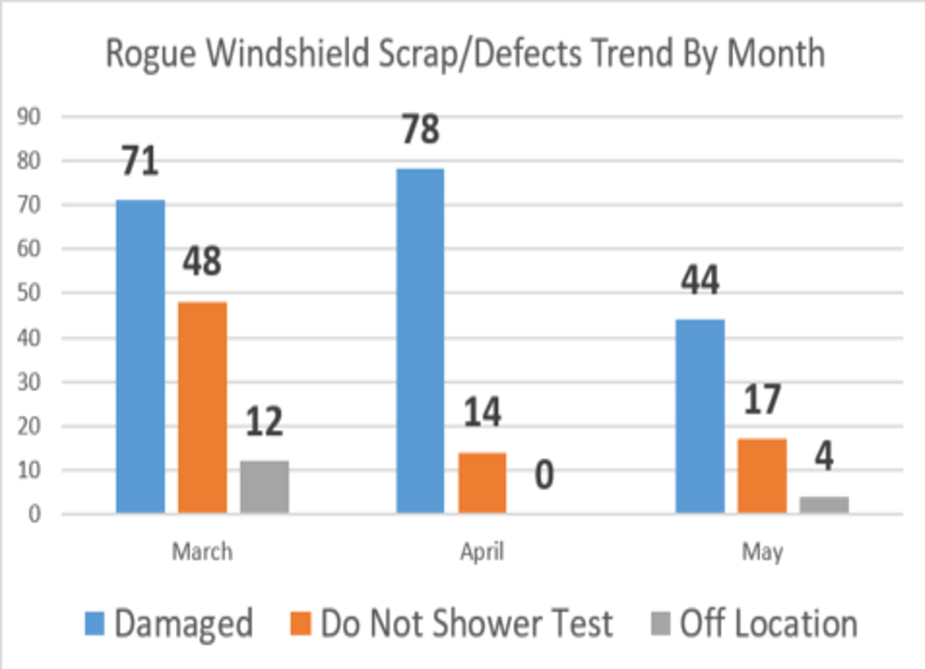
The data shows that the top focus item needs to be windshields. Currently the windshields being scrapped is our highest contributor to glass scrap. The data is not tied to the scrap data in Tableau, but the mentioned defects will always result in scrapped/replaced glass. The data trends show that model 1 windshields that are either damaged, “do not shower test”, or off location should be our highest priority. These three inspect data entry categories were chosen because all of these defects were caused by either damage in zone due to process or equipment, damage was found in zone or out of zone and the offline/leaders were aware of the issue, or were caused by the process not being followed correctly.
Focusing on these items allows us to focus on the process on the job, focus on the equipment, and how the offline/leaders/supervisors react to the defect.

Slide 4
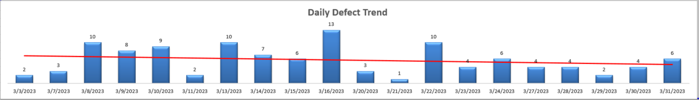
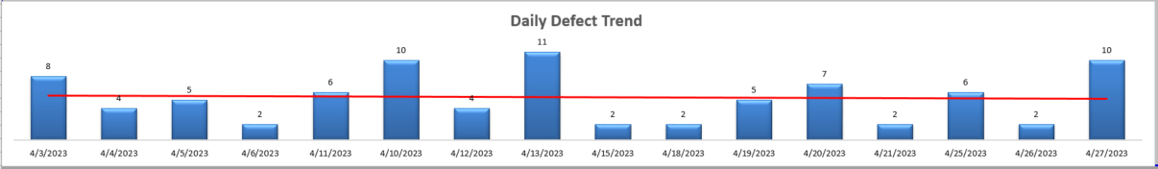
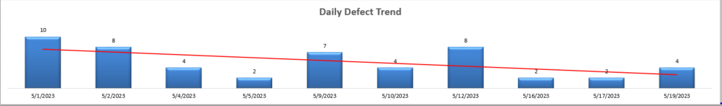
Daily Trend of Windshield Scrap / Defects Causing Scrap
- Daily Trend of model 1 Windshield Scrap/Defects Causing Scrap -

Slide 5
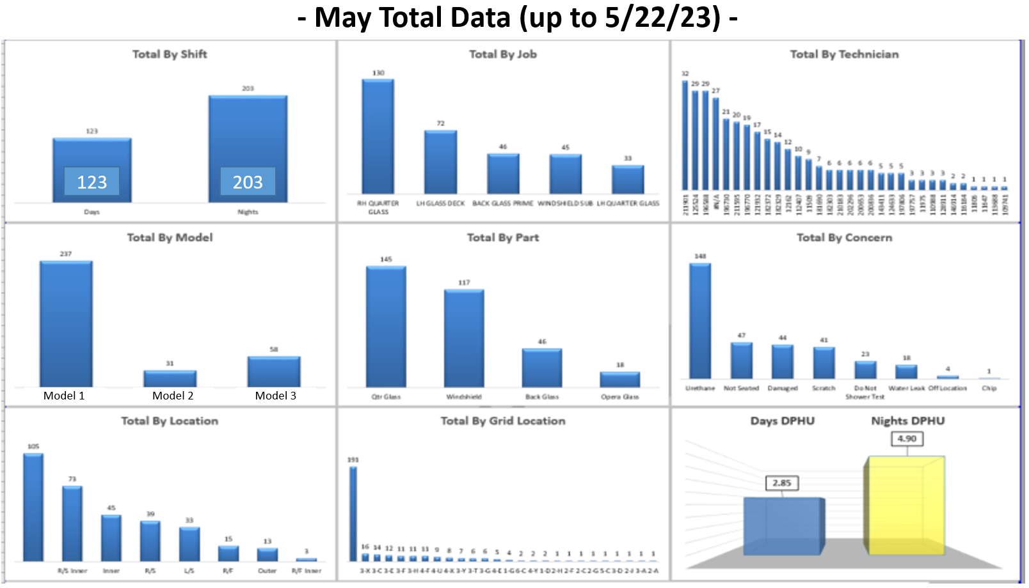
Model 1
Model 2
Model 3

Slide 6
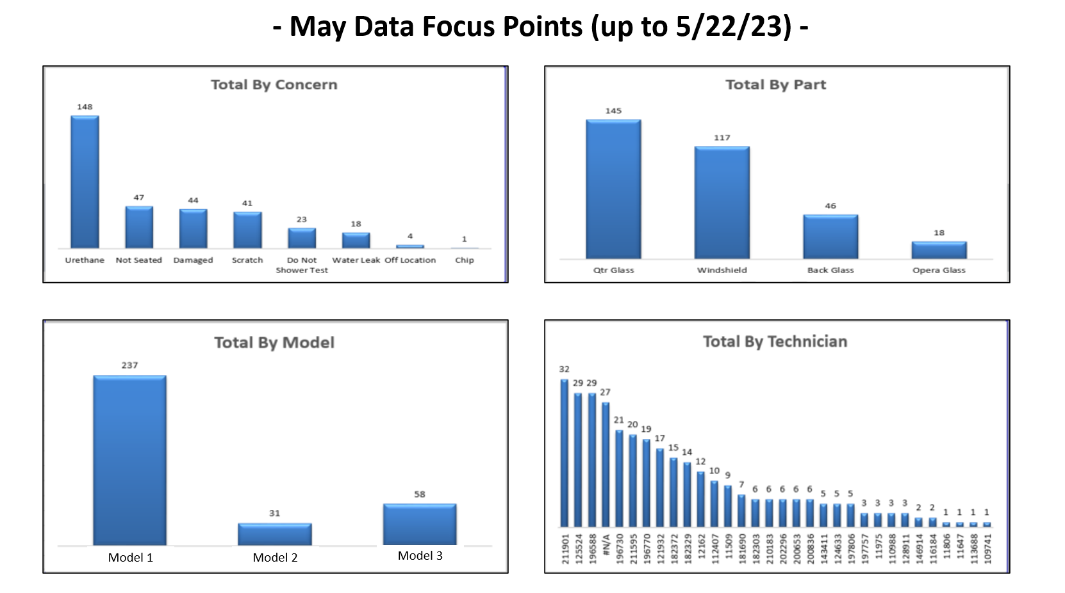

Slide 7
Man:
Model 1 windshield: Tech is coming in too low while decking and glancing the urethane off the detail.
Techs are not able to detect water leaks 100% when there is a water leak. Each windshield that has a water leak is a result of a misdeck or the urethane bead not being applied to the windshield accurately that is not caught within zone.
Method:
There is not a standard to stay in front of the windshield detail while lowering the glass and to come up and meet the detail while decking.
Job observations need to be performed on all techs to ensure that they are decking according to the best practice/standard.
Material:
Current details on model 1 are too tall causing techs to hit the detail with the urethane bead during the decking process.
The windshield opening needs to be measured to ensure that it is within spec.
The windshield needs to be measured to ensure that it is within spec.
Machine:
Confirmation is needed that the urethane bead is being applied accurately by the windshield robot.
The assist allows for uneven decking as it is connected to the balancer at its central point. Due to this there is room for error because both techs have to be completely synchronized during the decking process.
Measurement:
Confirmation is needed that the vision system for the urethane bead is accurately measuring the bead path and ensuring that it is within spec for location, width, and height.
Water leaks need to be charged as defects, reviewed on camera to find root cause and count toward job performance corrective action. This information also needs to be stored in a database to trend for patterns.
The scrap database from the scrap team does not tie a scrapped item to a sequence number. This causes the trending/data review process to take too much time. Each scrapped item’s sequence number must be requested via email to the scrap team.
Match each scrap item to scrap cost and sequence number. We are having a high amount of scrap even though we have a low number of defects for quarter glass not seated and windshield water leak issues.

Slide 8
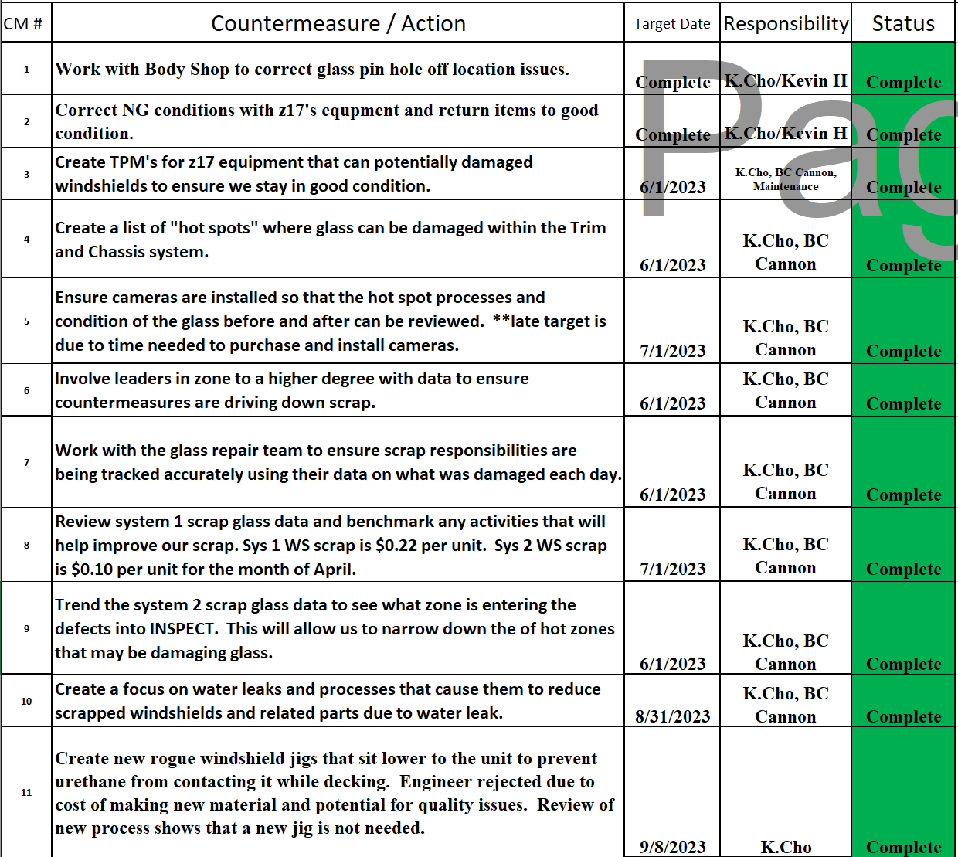
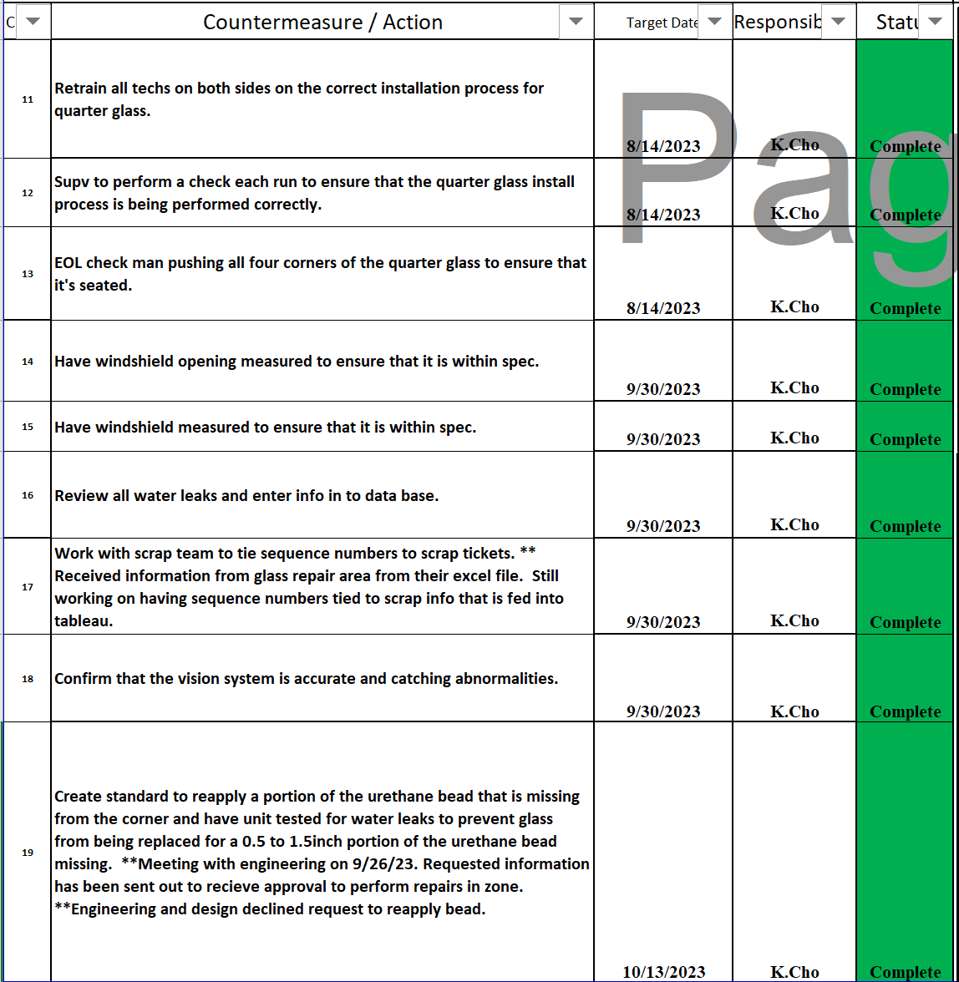

Slide 9
